Slide 1
Assignment 5 – Response Model Introduction to Data Analysis (DATA 1200) Prof. Ritwick Dutta
Dheer Parikh
100919437

Slide 2
Introduction
In this assignment we have to develop a response model for Mr. John for marketing campaign using dataset `Mktg_Campaign.csv`
In this dataset personal details such as number of kids, martial status, income is populated along with their purchasing preference of food items and amount of money they spend on it. In addition to that, activity on web and in store is also provided and now based on this after how many campaigns they accepted the offer is also provided and on the basis of all this we developed response model which says that if the customer accepted the offer in final campaigns

Slide 3
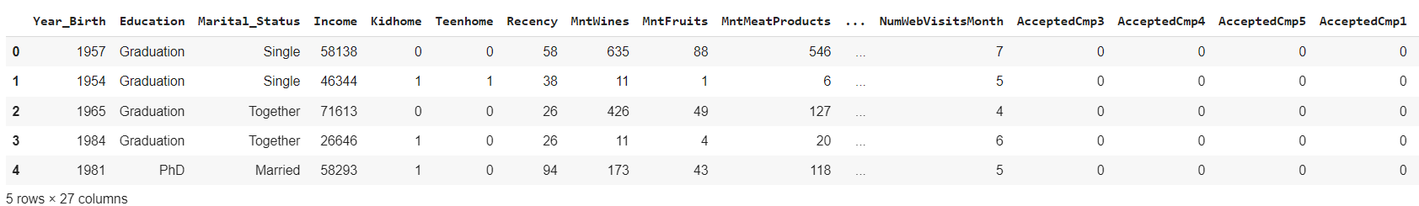
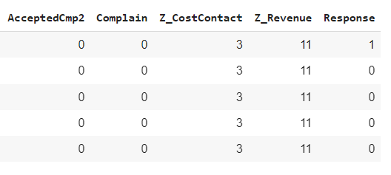
Understanding dataset:
Fig. 1 – first 5 rows of dataset
In this dataset we can see that after how many attempts (Campaigns) of marketing the customer has accepted the offer. In addition to that the birth year, Education, Martial Status, income, number of kids and teenager at house, minimum purchase of wine, fish, meat and their web visits along with their store visits are recorded and now based on this their response is recorded which is, did the customer accepted the offer in last campaign or not.
We can see that very minute details of customer is provided over here such as, how many times customer has visited the store in a month and using which catalog the customer has ordered the products.

Slide 4
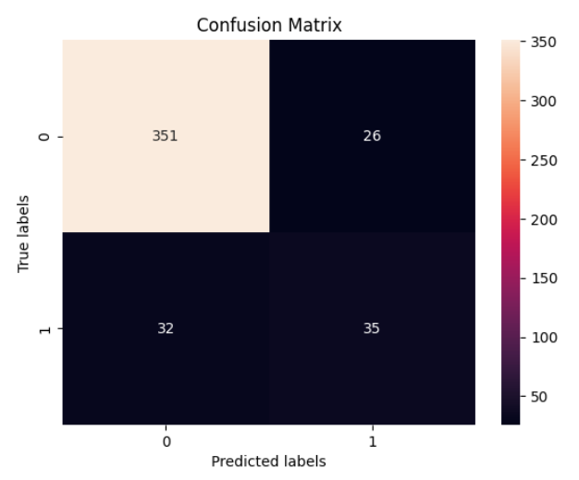
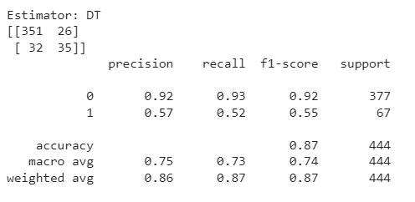
Interpretation of Decision Tree:
Fig. 2 – Performance Matrices
Fig. 3 – Confusion Matrices
The algorithm achieved the overall accuracy of 0.87 but it is noticeable that it predicted the customer who has not accepted the offer in last campaigns, the precision of 1 which the offered accepted by customer is very low. It means that dataset is highly imbalanced and it is very high precision for 0 and very low for 1 and in addition to that, the recall which is correctly identifying the positive outcomes for 1 is very low compared to 0.
From the confusion metrics we can see that there is a slight difference between False Negative and True positive.

Slide 5
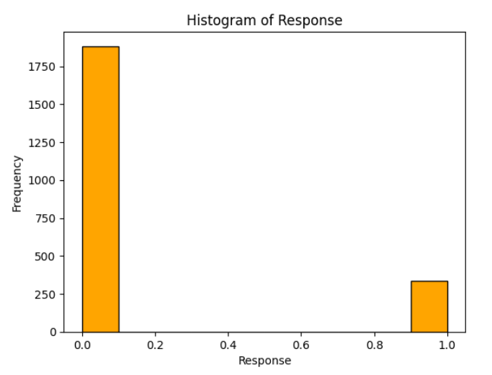
Recommendations & ways to improve model:
It can be seen that dataset is imbalanced by the graph below. There is nearly 3 to 4 times difference between 0 and 1.
Different algorithms such as Random Forest Regression should be employed as it takes in account the weighted average of every decision tree to predict the outcomes.
Correlation between dependent and independent variables should be reviewed properly as additional features which doesn’t have correlation with independent variable might be perturbing the outcomes.

